Slide 1

Next-Generation Multi-Functional Calculator
Design and Development of an Advanced Multi-Interface Computational System
Submitted By :- Yug Rathi

Slide 2
Introduction
Unit conversion is an essential requirement in various fields such as education, engineering, finance, and daily life.
Different measurement systems are used worldwide, creating the need for accurate and quick conversion between units.
Manual conversion methods can be complex, time-consuming, and prone to errors.
The Unit Converter Calculator is designed to provide a simple, fast, and reliable solution for converting multiple unit types in one application.
It offers an intuitive user interface and efficient functionality, ensuring a smooth and user-friendly experience.
The application helps users perform conversions accurately, improving productivity and reducing calculation effort.

Slide 3
Project Overview
The Unit Converter Calculator is a desktop-based application designed to perform accurate and instant unit conversions across multiple categories.
It integrates various conversion modules including Scientific, Programmer, Currency, Length, Speed, Volume, Data, and Angle, Etc into a single unified platform.
The application features a user-friendly interface with a consistent layout, enabling users to easily select units, input values, and view results.
It provides fast, reliable, and precise conversion results, improving efficiency and reducing manual calculation effort.
The system is designed with a modular and scalable architecture, allowing future expansion to support additional unit types and features.
This project demonstrates the implementation of logical processing, UI design, and real-world problem-solving in a practical software solution.

Slide 4
Problem Statement
Users often need to convert between different units such as currency, length, speed, volume, data, and angles in academic, professional, and daily activities.
Existing solutions are often fragmented, complex, or require internet access, making quick and efficient conversion difficult.
Many applications lack a simple, unified, and user-friendly interface for handling multiple conversion types in one place.
Manual conversion methods are time-consuming and prone to calculation errors.
There is a need for a reliable, accurate, and easy-to-use converter that integrates multiple unit conversion functionalities into a single application.

Slide 5
Learning Outcomes
Gained practical experience in designing and developing a user-friendly desktop application.
Learned to implement unit conversion logic and mathematical calculations accurately.
Improved skills in User Interface (UI) design and usability principles.
Understood the importance of structured programming and modular application design.
Developed knowledge of handling user input, processing data, and displaying results efficiently.
Enhanced problem-solving abilities and gained experience in building real-world software solutions.

Slide 6
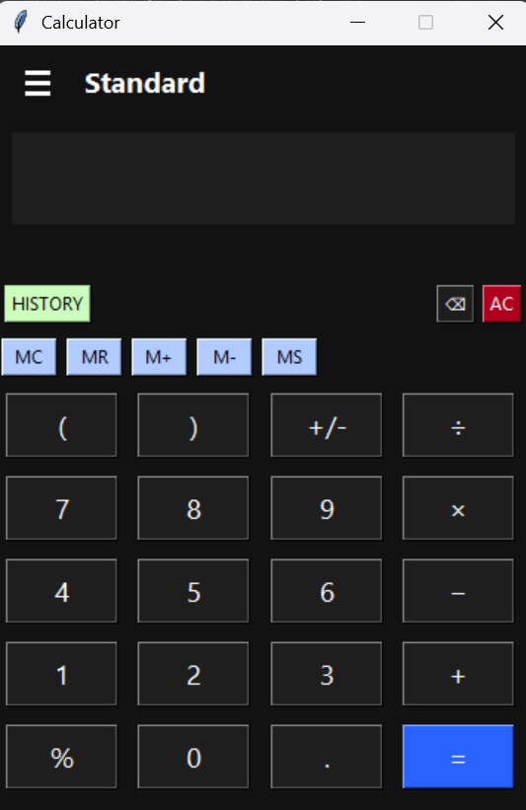
UI/UX Design Insights & Interface Analysis
1. Structured Grid-Based Layout
The calculator uses a clean grid system with uniformly sized buttons, ensuring visual balance, symmetry, and intuitive number placement following standard calculator conventions.
2. Clear Functional Grouping
Memory controls, numeric keypad, operators, and navigation menu are logically separated, improving usability and reducing cognitive load.
3. Visual Hierarchy & Action Emphasis
The blue "=" button is highlighted to indicate the primary action, guiding user focus and improving interaction clarity.
4. Scalable Multi-Mode Architecture
The slide-in navigation panel supports multiple calculator modes (Standard, Scientific, Converters), demonstrating modular and expandable UI design.

Slide 7
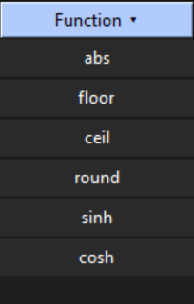
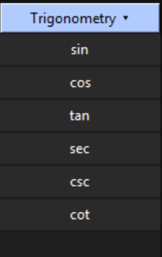
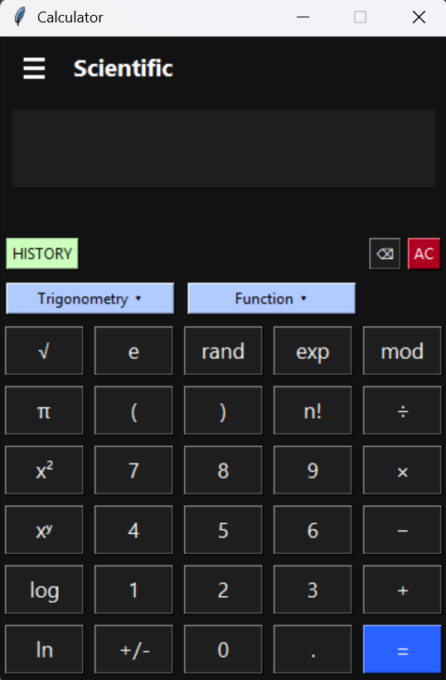
Advanced Scientific Calculator Interface & Functional Design
1. Progressive Feature Disclosure
Scientific functions are organized under dropdown menus (Trigonometry & Function), preventing interface overload while maintaining access to advanced operations.
2. Advanced Mathematical Integration
The interface supports higher-level operations such as factorial (n!), exponentiation (xʸ), logarithmic functions (log, ln), constants (π, e), and random generation, expanding capability beyond basic arithmetic.
3. Dual-Layer Function Categorization
Mathematical operations are intelligently separated into:
Trigonometric functions (sin, cos, tan, etc.)
Analytical functions (abs, floor, ceil, round, hyperbolic functions)
This improves conceptual clarity and structured learning.
4. Extended 5-Column Layout Optimization
The keypad expands from standard 4-column to 5-column layout, efficiently accommodating scientific operations without compromising button readability or spacing consistency.

Slide 8
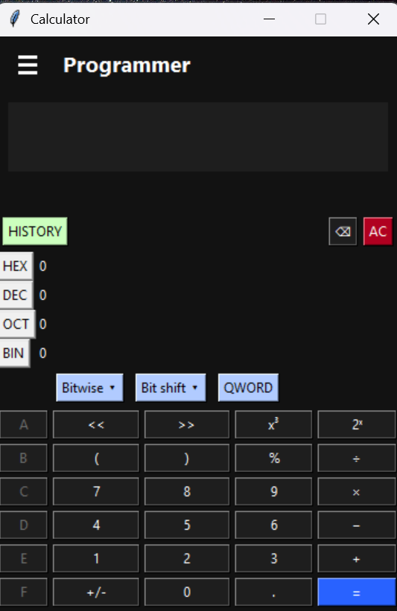
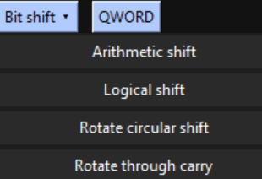
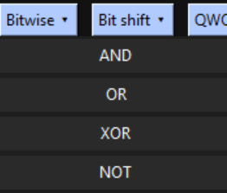
Programmer Mode: Binary Logic & Bit-Level Computation Framework
1. Multi-Base Number System Support
The interface enables real-time conversion between HEX, DEC, OCT, and BIN formats, allowing efficient cross-representation of numerical data.
2. Integrated Bitwise Logic Operations
Dedicated dropdown for AND, OR, XOR, and NOT operations provides low-level logical computation essential for programming and digital circuit analysis.
3. Advanced Bit Manipulation Controls
Includes arithmetic shift, logical shift, rotate circular shift, and rotate through carry — demonstrating hardware-level computation simulation.
4. Extended Alphanumeric Keypad (A–F)
Hexadecimal digit buttons (A–F) are seamlessly integrated into the layout, ensuring compatibility with base-16 input without disrupting numeric structure.

Slide 9
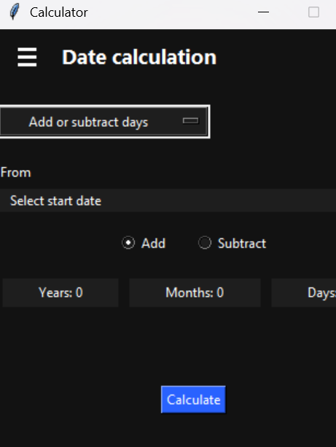
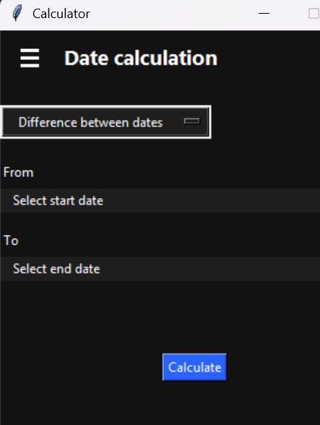
Date Calculation Module: Temporal Computation & Scheduling Framework
1. Dual-Mode Date Processing System
The interface supports both date difference calculation and date increment/decrement operations, enabling flexible time-based computations within a single module. 2. Structured Temporal Input Design
Separate "From" and "To" date selectors ensure logical chronological flow and reduce user input ambiguity.
3. Granular Time Manipulation Controls
Year, Month, and Day input fields allow precise temporal adjustments, improving accuracy in long-term scheduling or forecasting calculations.
4. Context-Sensitive Interaction Model
Dynamic UI changes (Difference mode vs Add/Subtract mode) adapt the input fields based on selected operation, enhancing usability and reducing visual clutter.

Slide 10
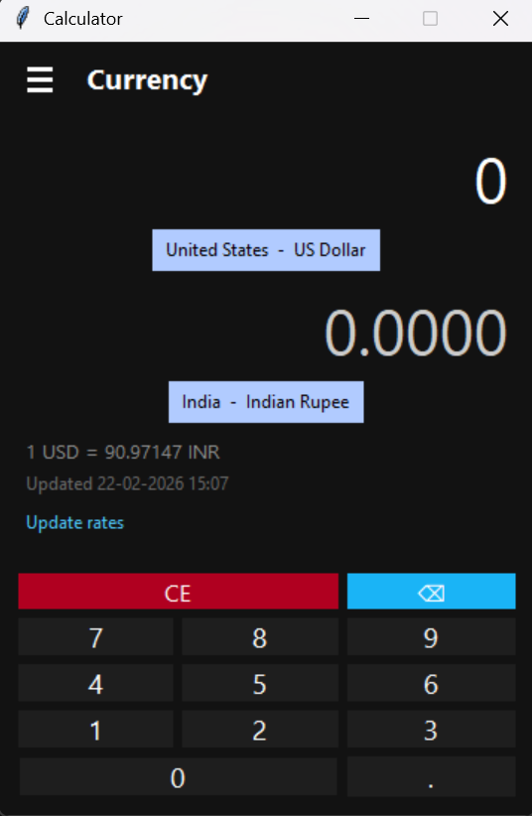
Currency Converter Interface: Key Design Insights and Features
1️⃣ Real-Time Exchange Transparency
The interface clearly displays the live conversion rate (e.g., 1 USD = 90.97147 INR) along with the last updated timestamp.
✅ Builds trust and credibility
✅ Enhances financial accuracy awareness
✅ Makes the app feel dynamic and data-driven
2️⃣ Clean Dark-Themed Financial UI
The dark background with high-contrast typography improves readability and reduces eye strain.
✅ Professional and modern aesthetic
✅ Focus stays on numerical values
✅ Ideal for frequent or long-duration usage
3️⃣ Seamless Global Currency Access
The dropdown provides an extensive list of international currencies in a structured format (Country – Currency).
✅ Easy global accessibility
✅ Scalable for worldwide users
✅ Enhances usability for travelers and traders
4️⃣ Optimized Numeric Input Experience
Large keypad layout with dedicated clear (CE) and delete buttons ensures smooth data entry.
✅ User-friendly interaction
✅ Reduces input errors
✅ Familiar calculator experience for all age groups

Slide 11
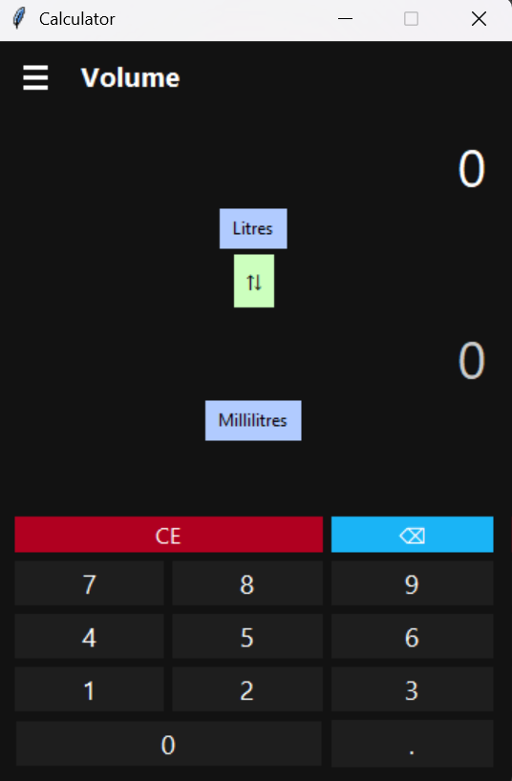
Designing an Intuitive and Scalable Volume Conversion Interface
1️⃣ Bidirectional Conversion Control
The swap button allows users to instantly reverse conversion units (Liters ↔ Milliliters), improving efficiency and eliminating the need for manual re-selection.
2️⃣ Wide Range of Measurement Units
Supports multiple volume units including Liters, Milliliters, Cubic meters, Teaspoons, and Gallons, making the tool versatile for scientific, daily, and international use.
3️⃣ Minimal and Focused Layout
The interface highlights only essential elements—input, output, and unit selection—reducing cognitive load and enabling faster, distraction-free conversions.
4️⃣ Consistent Calculator Interaction Model
The familiar numeric keypad with clear and delete options ensures accurate input and provides a smooth, error-controlled user experience.

Slide 12
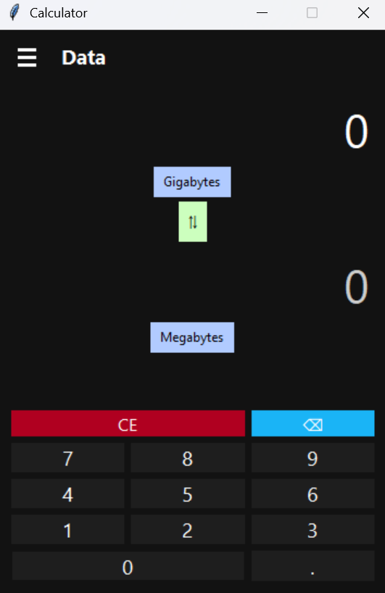
Efficient Digital Data Conversion with Intuitive Interface Design
1️⃣ Support for Multiple Digital Storage Units
The interface enables conversion between various data units such as Gigabytes, Megabytes, and others, making it useful for technical, academic, and general computing needs.
2️⃣ Quick Unit Switching for Flexible Workflow
The dedicated swap control allows users to instantly reverse conversion direction, improving speed and enhancing workflow efficiency.
3️⃣ Clear Visual Separation of Input and Output
Distinct placement of input and result values ensures users can easily differentiate between entered data and converted output, reducing confusion.
4️⃣ Consistent and Scalable Design Architecture
The interface follows a uniform layout pattern, allowing easy extension to additional unit categories while maintaining usability consistency.

Slide 13
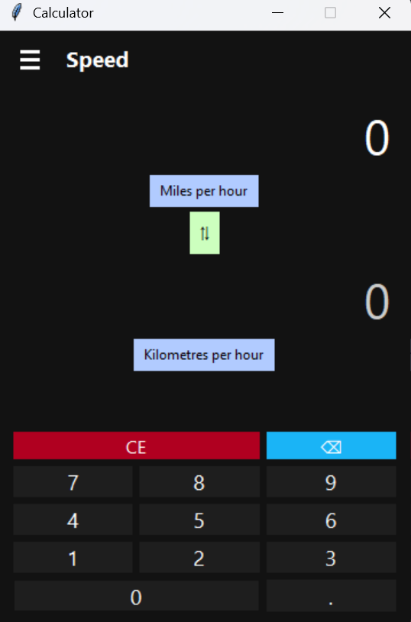
Accurate Speed Conversion with Streamlined User Interaction
1️⃣ Real-World Unit Relevance
Supports commonly used speed units like Miles per hour and Kilometers per hour, making it practical for travel, automotive, and academic applications.
2️⃣ Instant Direction Reversal
The integrated swap feature allows quick interchange of units, enabling fast comparative analysis without re-entering data.
3️⃣ High-Visibility Numerical Display
Large, clearly separated input and output values enhance readability and minimize misinterpretation during conversions.
4️⃣ Uniform Cross-Module Design
Maintains consistent layout and interaction patterns across converter types, improving user familiarity and reducing the learning curve.

Slide 14
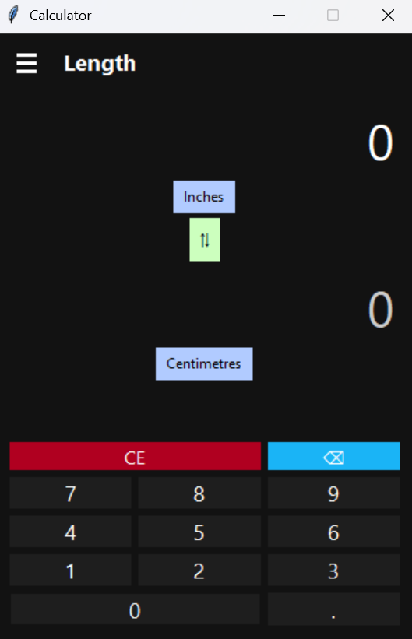
Precise Length Conversion with User-Friendly Interface Design
1️⃣ Practical Measurement Unit Support
Includes commonly used units like Inches and Centimeters, making it suitable for academic, engineering, and everyday measurement tasks.
2️⃣ Efficient Two-Way Conversion Mechanism
The swap control enables instant reversal between units, allowing users to perform conversions quickly without additional steps.
3️⃣ Clear and Structured Information Layout
The vertical arrangement of units and values ensures logical flow, helping users easily understand the conversion process.
4️⃣ Familiar and Error-Resistant Input System
Integrated calculator keypad with clear and delete functions ensures accurate input and smooth interaction.

Slide 15
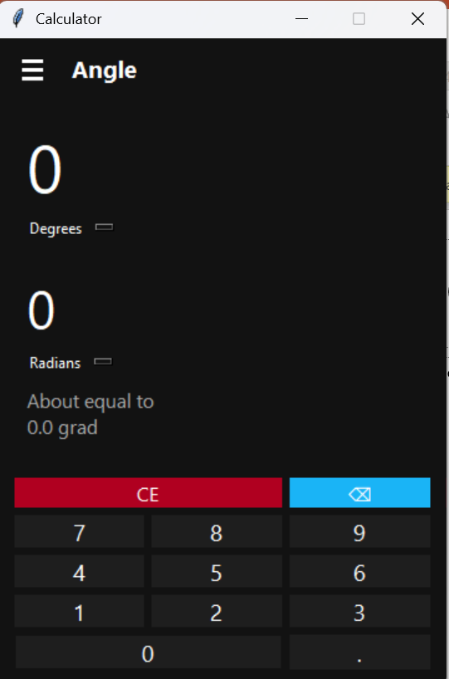
Accurate Angle Conversion with Multi-Unit Representation
1️⃣ Multi-Unit Angle Representation
Supports conversion between Degrees, Radians, and Grad, making it useful for mathematics, engineering, and scientific applications.
2️⃣ Simultaneous Conversion Display
Shows equivalent values across different angle units at the same time, allowing users to compare results instantly without switching views.
3️⃣ Informative Approximation Feature
The “About equal to” section provides an additional reference value, enhancing user understanding of equivalent measurements.
4️⃣ Simple and Precision-Focused Layout
Minimal interface design ensures focus on accuracy and clarity, helping users perform conversions efficiently.

Slide 16

Final Conclusion
Successfully designed and developed a multi-functional unit converter calculator with an intuitive and user-friendly interface.
The system supports multiple conversion categories, including Standard, Scientific, Programmer, Currency, Length, Speed, Volume, Data, and Angle, etc. making it versatile and practical.
The application ensures high accuracy, real-time functionality, and efficient user interaction through a consistent and structured design.
Features like instant unit switching, clear input controls, and organized layout enhance usability and reduce user effort.
The modular and scalable design allows easy expansion to support additional unit categories in the future.
Overall, the project demonstrates effective integration of UI design, logical processing, and real-world functionality into a reliable conversion tool.

Slide 17
Thank You
Thank you for your time and attention.
This project represents the successful development of a multi-functional unit converter calculator with a focus on accuracy, usability, and efficient interface design.
Your valuable feedback and suggestions are welcome.

